Slide 1
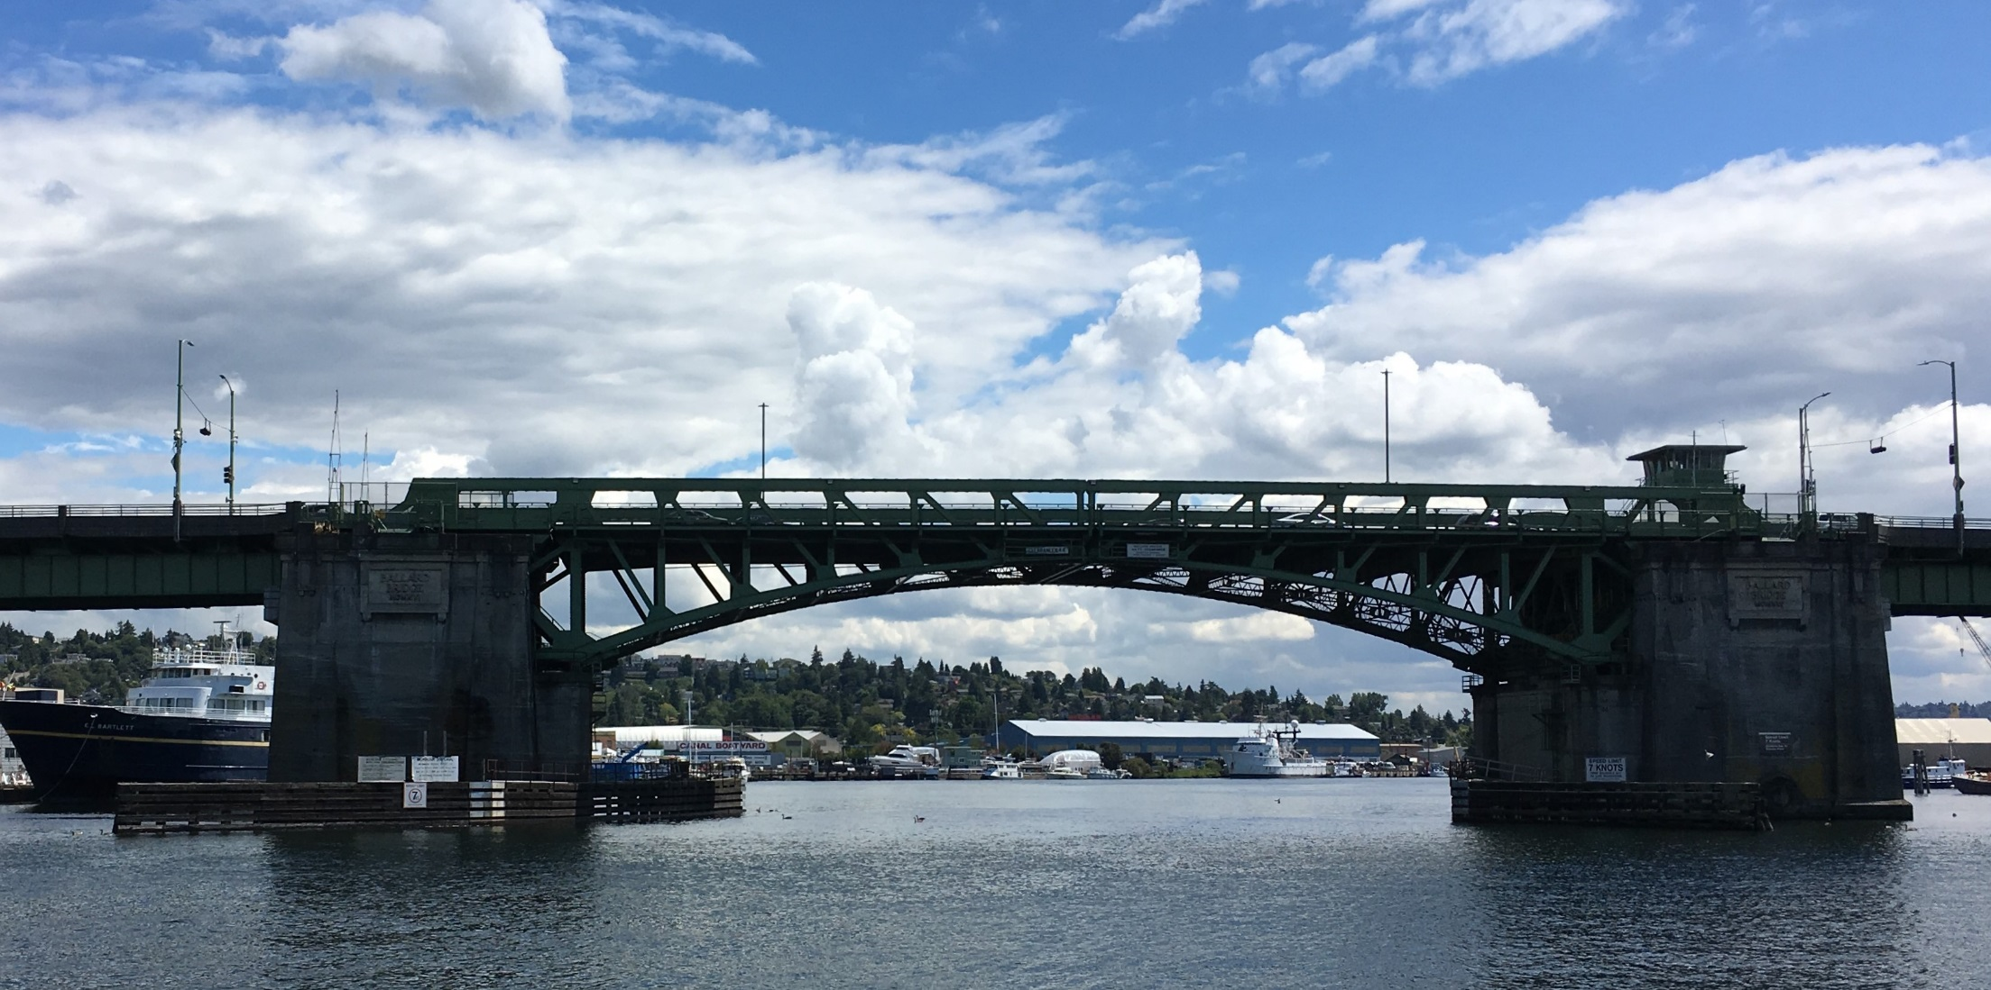

Ballard Bridge Planning Study
Wes Ducey
June 2019

Slide 2
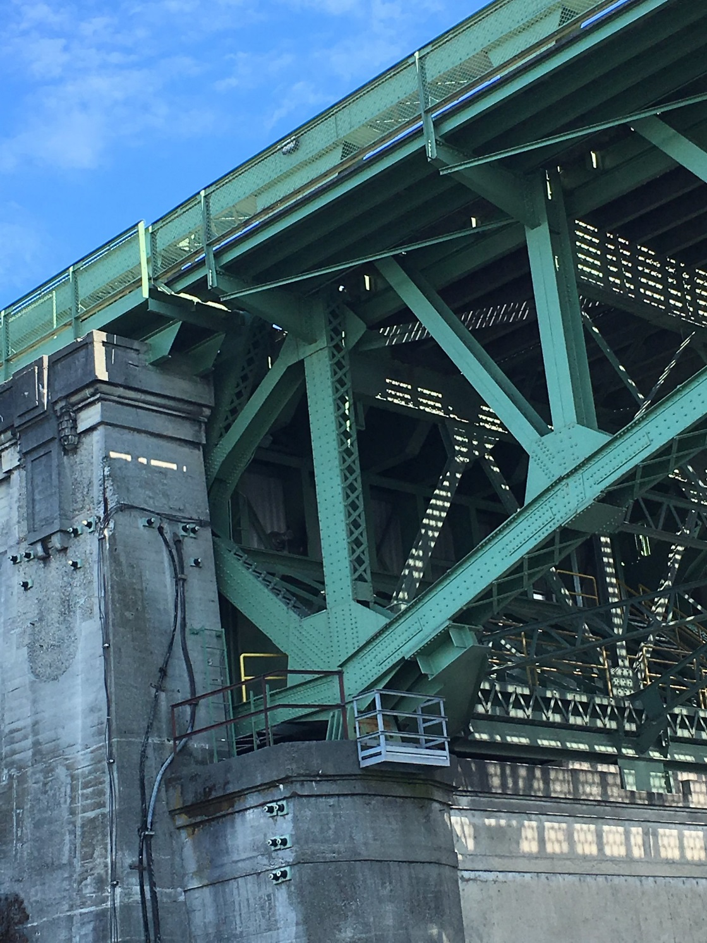
Agenda
Purpose and need
Scope of work
Concepts
Planning process
Next Steps
2

Slide 3
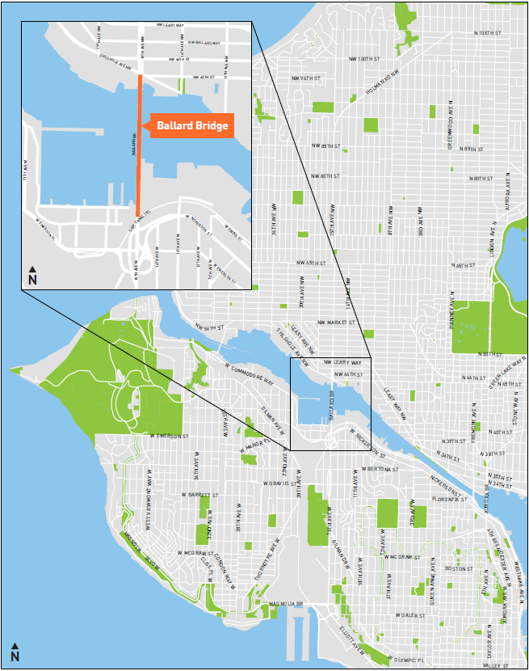
Purpose & Need
Critical land and marine connection
Operations and safety maintained, but 100+ years old
Current transportation, functional, and structural standards need to be incorporated long-term
3

Slide 4
Scope of Work
Explore future bridge rehabilitation and replacement options
Identify associated costs and trade-offs
Consider geometric layouts and constructability
Conduct traffic Analysis
Engage community
4

Slide 5
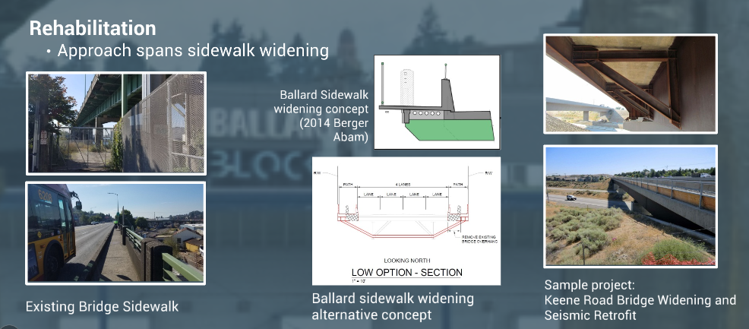
Concept 1: Major rehabilitation
Consider how to rehabilitate existing structure and upgrade bicycle and pedestrian faculties
5

Slide 6
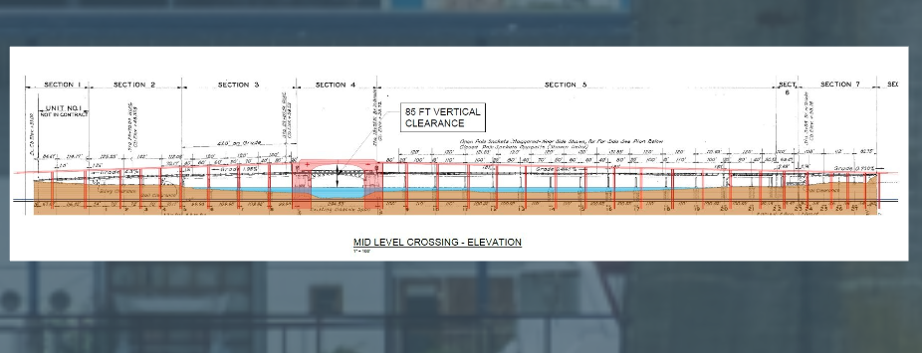
Concept 2: Movable replacement bridge
Consider what to include if building a structure that operates similar to day
6

Slide 7
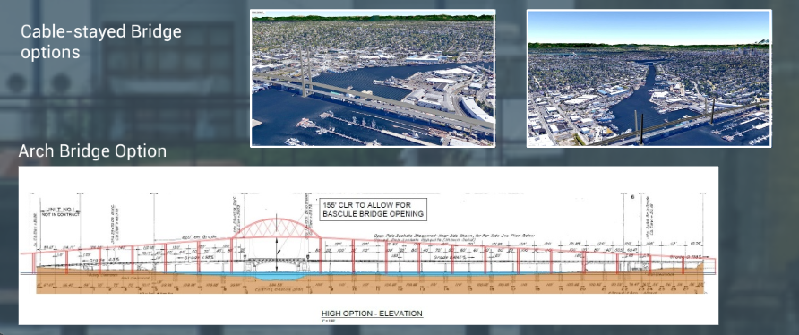
Concepts 3: Fixed replacement bridge
Consider concepts for a bridge supporting marine traffic without having to open
7

Slide 8
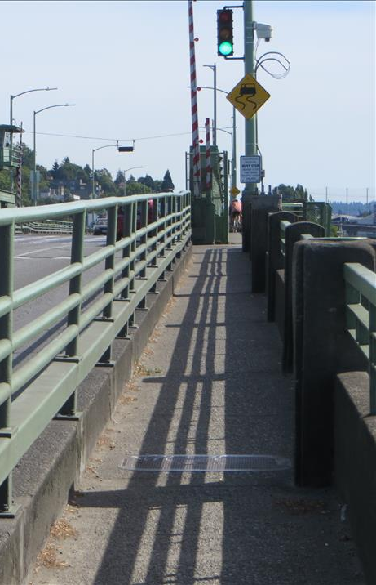
Opportunities & Considerations
Bike and pedestrian safety
Transit and freight reliability
Industrial operations
Constructability
Marine and road traffic impacts
Adjacent project coordination
Environmental impacts to waterway
What else?
8

Slide 9
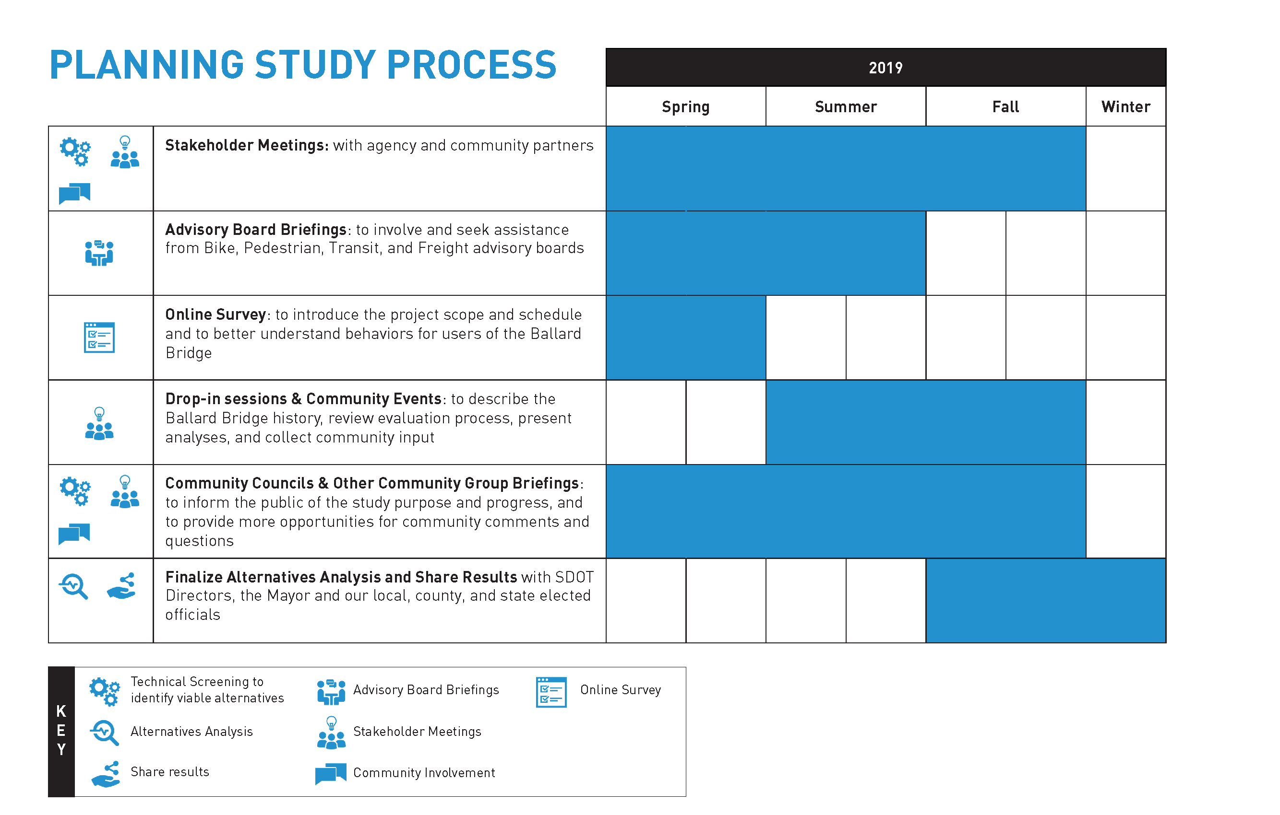
Subject to change

Slide 10
Next steps
Launch online survey to understand community’s needs and values – going live soon
    Help spread the word!
Present to advisory boards
Start geometric and traffic analysis

Slide 11





Questions?
BallardBridge@seattle.gov | (206) 775-8894
www.seattle.gov/transportation

